Slide 1
GEAR
CONTENTS
POWER TRANSMISSION
GEAR
TYPES OF GEARS
NOMENCLATURE
APPLICATIONS OF GEARS
VELOCITY RATIO
GEAR TRAINS
EXAMPLE PROBLEMS AND QUESTIONS

Slide 2
GEAR…..
Power transmission is the movement of energy from its place of generation to a location where it is applied to performing useful work
A gear is a component within a transmission device that transmits rotational force to another gear or device

Slide 3
TYPES OF GEARS
1. According to the position of axes of the shafts.
Parallel
1.Spur Gear
2.Helical Gear
3.Rack and Pinion
b. Intersecting
Bevel Gear
c. Non-intersecting and Non-parallel
worm and worm gears

Slide 4
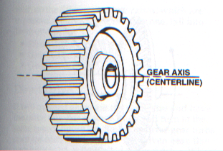
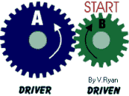
SPUR GEAR
Teeth is parallel to axis of rotation
Transmit power from one shaft to another parallel shaft
Used in Electric screwdriver, oscillating sprinkler, windup alarm clock, washing machine and clothes dryer

Slide 5
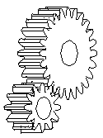
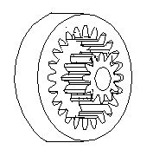
External and Internal spur Gear…

Slide 6
Helical Gear
The teeth on helical gears are cut at an angle to the face of the gear
This gradual engagement makes helical gears operate much more smoothly and quietly than spur gears
One interesting thing about helical gears is that if the angles of the gear teeth are correct, they can be mounted on perpendicular shafts, adjusting the rotation angle by 90 degrees

Slide 7
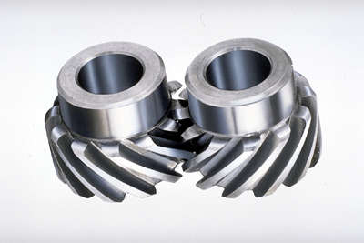
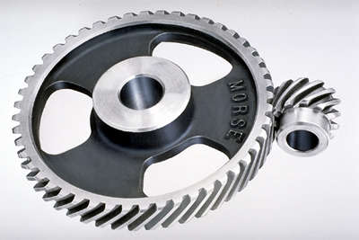
Helical Gear…

Slide 8
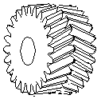
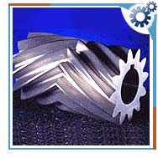
Herringbone gears
To avoid axial thrust, two helical gears of opposite hand can be mounted side by side, to cancel resulting thrust forces
Herringbone gears are mostly used on heavy machinery.

Slide 9
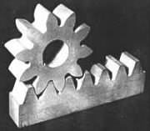
Rack and pinion
Rack and pinion gears are used to convert rotation (From the pinion) into linear motion (of the rack)
A perfect example of this is the steering system on many cars

Slide 10
Bevel gears
Bevel gears are useful when the direction of a shaft's rotation needs to be changed
They are usually mounted on shafts that are 90 degrees apart, but can be designed to work at other angles as well
The teeth on bevel gears can be straight, spiral or hypoid
locomotives, marine applications, automobiles, printing presses, cooling towers, power plants, steel plants, railway track inspection machines, etc.

Slide 11
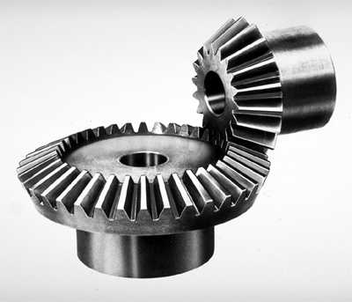
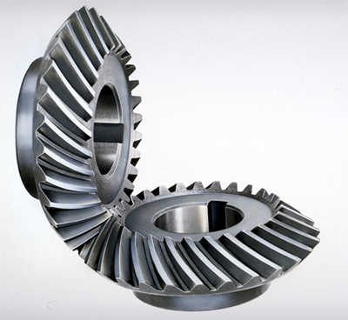
Straight and Spiral Bevel Gears

Slide 12
WORM AND WORM GEAR
Worm gears are used when large gear reductions are needed. It is common for worm gears to have reductions of 20:1, and even up to 300:1 or greater
Many worm gears have an interesting property that no other gear set has: the worm can easily turn the gear, but the gear cannot turn the worm
Worm gears are used widely in material handling and transportation machinery, machine tools, automobiles etc

Slide 13
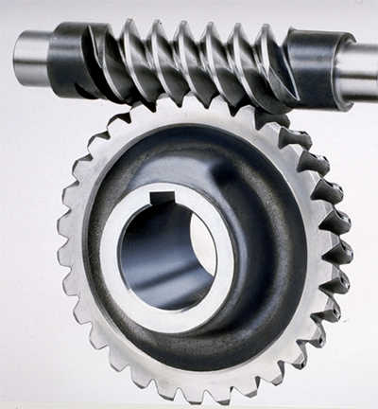
WORM AND WORM GEAR

Slide 14
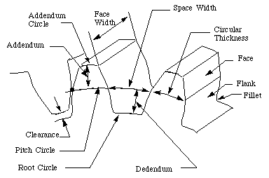
NOMENCLATURE OF SPUR GEARS

Slide 15
NOMENCLATURE….
Pitch surface: The surface of the imaginary rolling cylinder (cone, etc.) that the toothed gear may be considered to replace.
Pitch circle: A right section of the pitch surface.
Addendum circle: A circle bounding the ends of the teeth, in a right section of the gear.
Root (or dedendum) circle: The circle bounding the spaces between the teeth, in a right section of the gear.
Addendum: The radial distance between the pitch circle and the addendum circle.
Dedendum: The radial distance between the pitch circle and the root circle.
Clearance: The difference between the dedendum of one gear and the addendum of the mating gear.

Slide 16
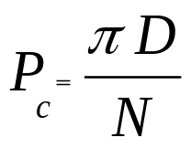
NOMENCLATURE….
Face of a tooth: That part of the tooth surface lying outside the pitch surface.
Flank of a tooth: The part of the tooth surface lying inside the pitch surface.
Circular thickness (also called the tooth thickness): The thickness of the tooth measured on the pitch circle. It is the length of an arc and not the length of a straight line.
Tooth space: pitch diameter The distance between adjacent teeth measured on the pitch circle.
Backlash: The difference between the circle thickness of one gear and the tooth space of the mating gear.
Circular pitch (Pc) : The width of a tooth and a space, measured on the pitch circle.

Slide 17
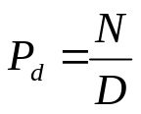
NOMENCLATURE….
Diametral pitch (Pd): The number of teeth of a gear unit pitch diameter. The diametral pitch is, by definition, the number of teeth divided by the pitch diameter. That is,
Where
Pd = diametral pitch
N = number of teeth
D = pitch diameter
Module (m): Pitch diameter divided by number of teeth. The pitch diameter is usually specified in inches or millimeters; in the former case the module is the inverse of diametral pitch.
m = D/N

Slide 18
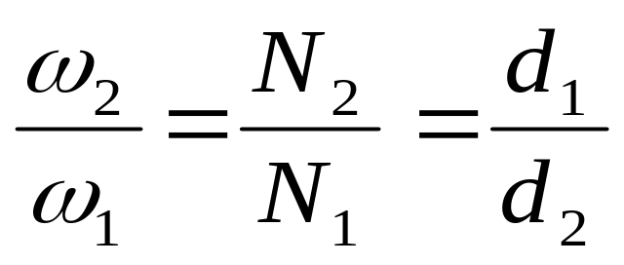
VELOCITY RATIO OF GEAR DRIVE
d = Diameter of the wheel
N =Speed of the wheel
ω = Angular speed
velocity ratio (n) =

Slide 19
GEAR TRAINS
A gear train is two or more gear working together by meshing their teeth and turning each other in a system to generate power and speed
It reduces speed and increases torque
Electric motors are used with the gear systems to reduce the speed and increase the torque

Slide 20
Types of Gear Trains
Simple gear train
Compound gear train
Planetary gear train
Simple Gear Train
The most common of the gear train is the gear pair connecting parallel shafts. The teeth of this type can be spur, helical or herringbone.
Only one gear may rotate about a single axis

Slide 21
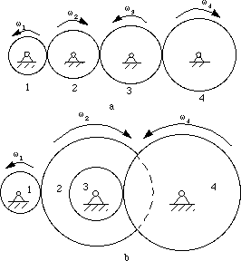
Simple Gear Train

Slide 22
Compound Gear Train
For large velocities, compound arrangement is preferred
Two or more gears may rotate about a single axis

Slide 23
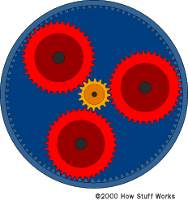
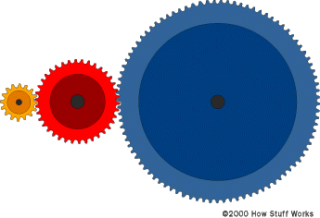
Planetary Gear Train (Epicyclic Gear Train)

Slide 24
Planetary Gear Train…
In this train, the blue gear has six times the diameter of the yellow gear
The size of the red gear is not important because it is just there to reverse the direction of rotation
In this gear system, the yellow gear (the sun) engages all three red gears (the planets) simultaneously
All three are attached to a plate (the planet carrier), and they engage the inside of the blue gear (the ring) instead of the outside.

Slide 25
Planetary Gear Train…
Because there are three red gears instead of one, this gear train is extremely rugged.
planetary gear sets is that they can produce different gear ratios depending on which gear you use as the input, which gear you use as the output, and which one you hold still.

Slide 26
Planetary Gear Train…
They have higher gear ratios.
They are popular for automatic transmissions in automobiles.
They are also used in bicycles for controlling power of pedaling automatically or manually.
They are also used for power train between internal combustion engine and an electric motor

Slide 27
Short Quetions
  What is power transmission?
  Why gear drives are called positively driven?
  What is backlash in gears?
  What are the types of gears available?
  What is gear train? Why gear trains are used?
  Why intermediate gear in simple gear train is called idler?
  What is the advantage of using helical gear over spur gear?
  List out the applications of gears
  Define the term ‘module’ in gear tooth
  What is herringbone gear?

Slide 28
Essay type questions
With sketch explain various types of gears
With sketch explain three types of gear trains
With neat sketch explain the nomenclature of spur gear
Write the applications, advantages and disadvantages of gear drives

